Slide 1
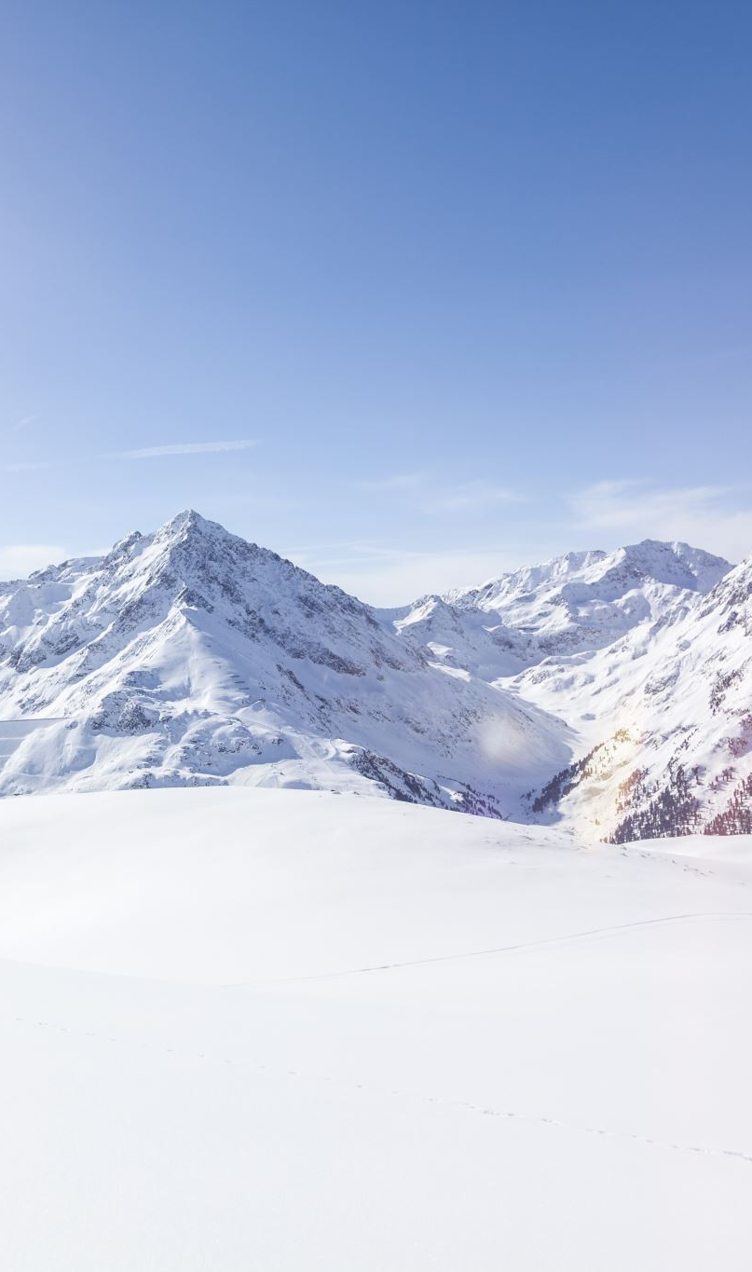
Big Mountain Resort
Executive Presentation
Elizabeth Rogers

Slide 2
Problem Identification
Current ticket price: $81
About 350,000 people visit annually
Big Mountain Resort’s current pricing strategy amounts to a premium placed on other Montana resorts’ prices
Overall, there is uncertainty about the relative value of BMR’s features
Desirable future steps and optimal ticket prices therefore unclear

Slide 3
Problem Identification
BMR’s vertical drop is 2,353 ft
Longest run = 3.3 miles
11 chair lifts, two T-bars and one magic carpet
Adding an additional lift adds $1,540,000 to seasonal operating costs
Add a chair lift? Increase the vertical drop? Add snowmaking acres? Increase the longest run’s distance? Drop runs?
A machine-learning model which takes other resorts’ features and prices into account is necessary to determine which scenarios have merit.

Slide 4
Recommendation and Key Findings
A random forest regressor model was isolated using the resort data
Key features were isolated using this and a linear regression model to point towards correlation with ticket price
Key correlative features: fast quads, runs, snow-making area, total vertical drop, and total number of chairs
Recommended steps based on the random forest regressor model’s predictions:
Increase the current ticket price by about $4.48
Increases revenue by $7,840,000
Extend vertical drop by at least 150 feet
Add 1 chair lift
Projected cost of $1,540,000

Slide 5
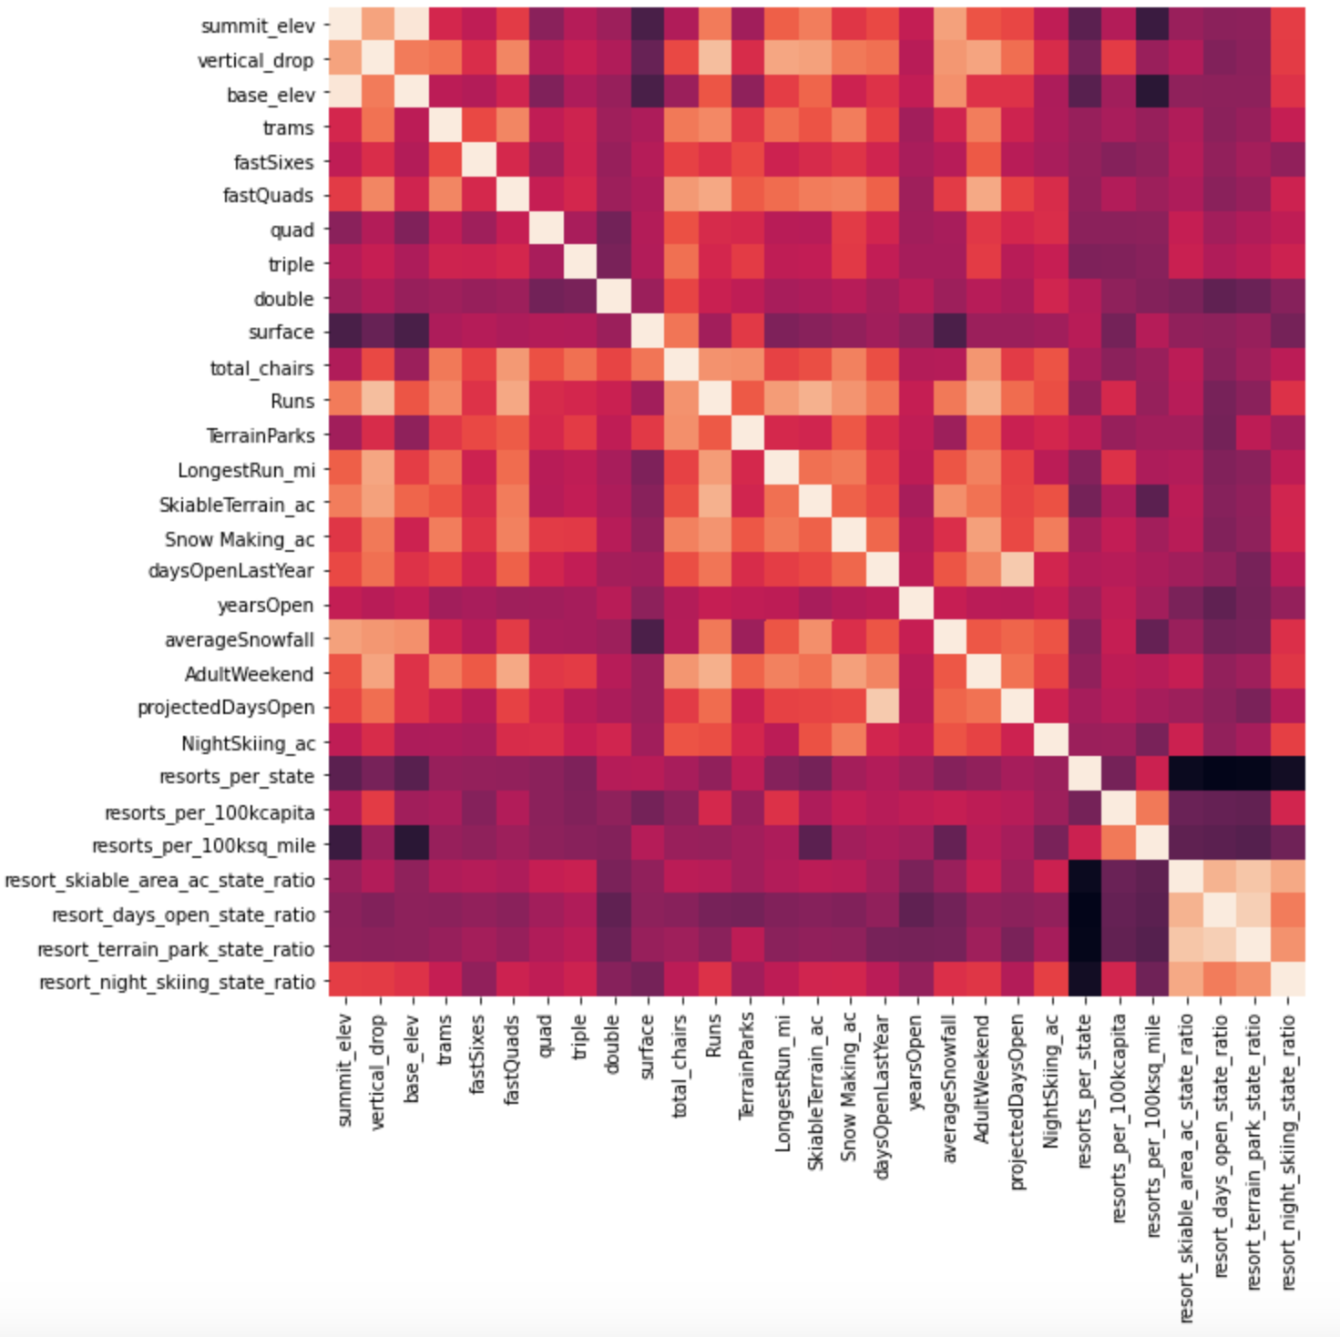
Modeling Results and Analysis
Heatmap of correlation:

Slide 6
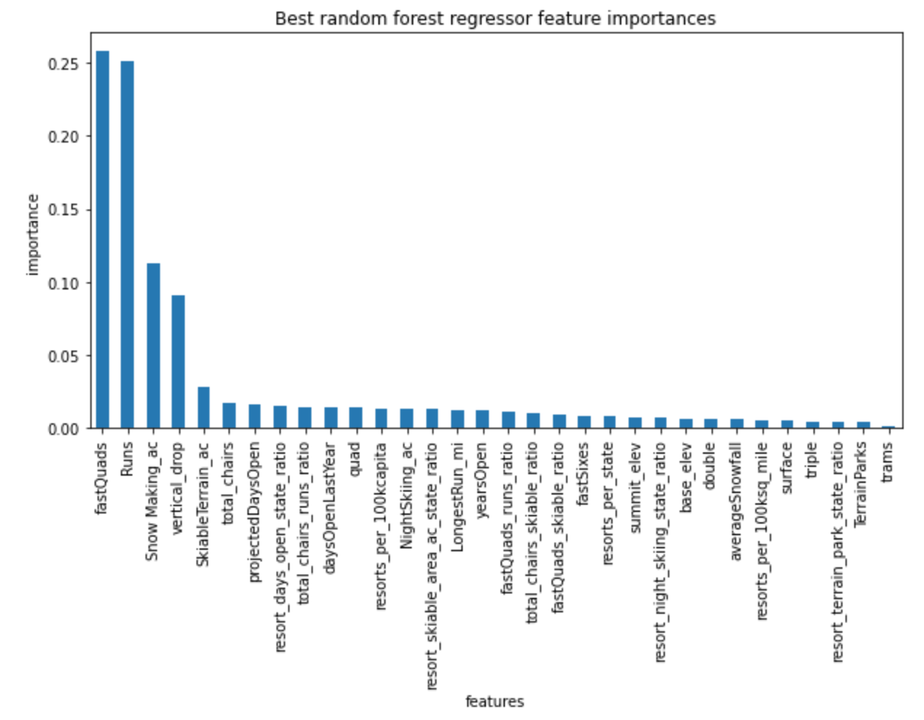
Modeling Results and Analysis
Best random forest regressor model’s feature importance:

Slide 7
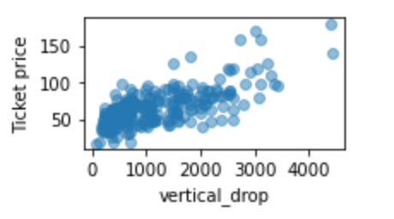
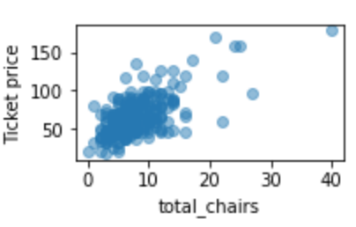
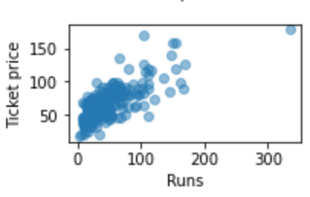
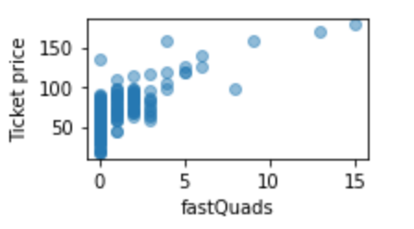
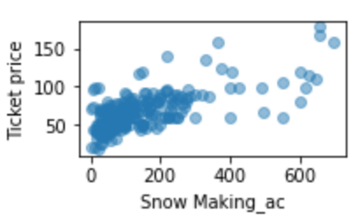
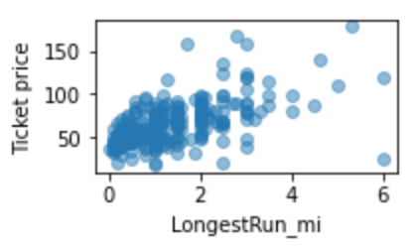
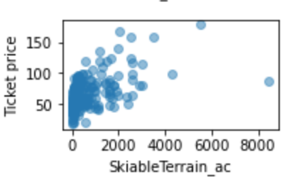
Modeling Results and Analysis
Correlations with ticket price visualized in scatterplots:

Slide 8
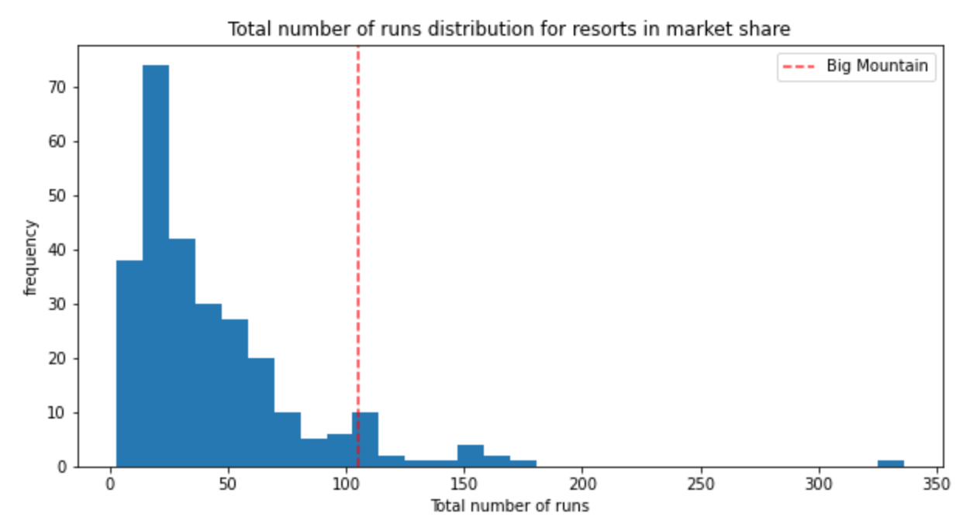
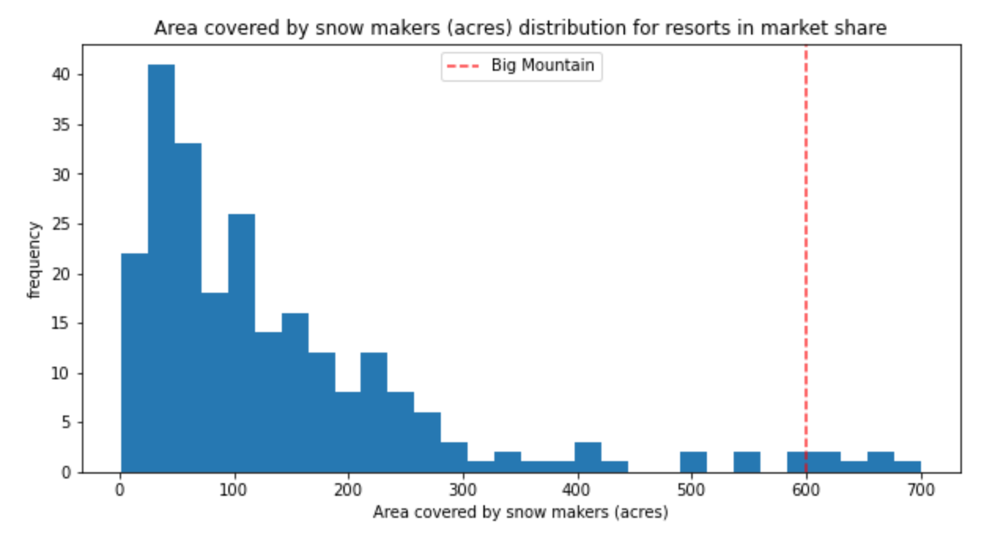
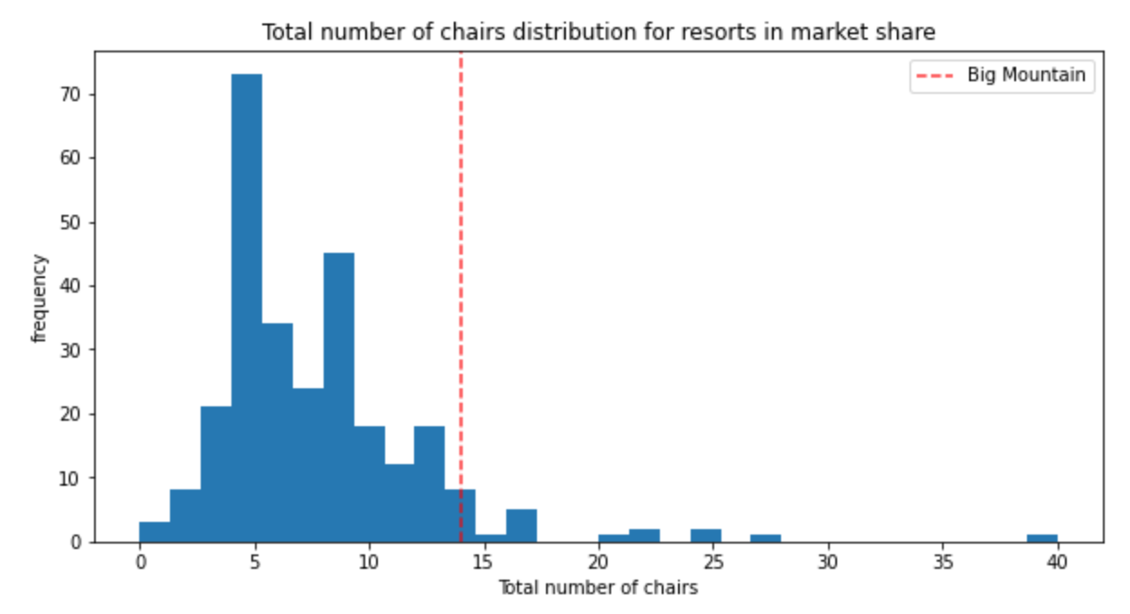
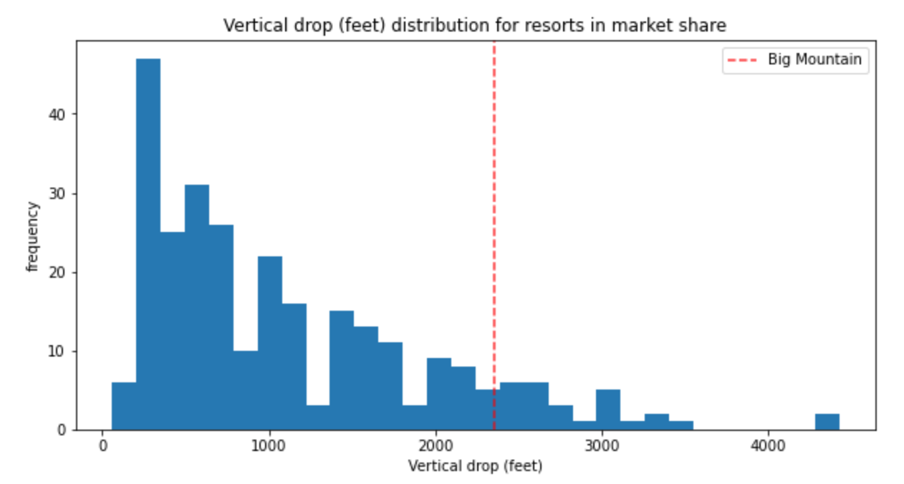
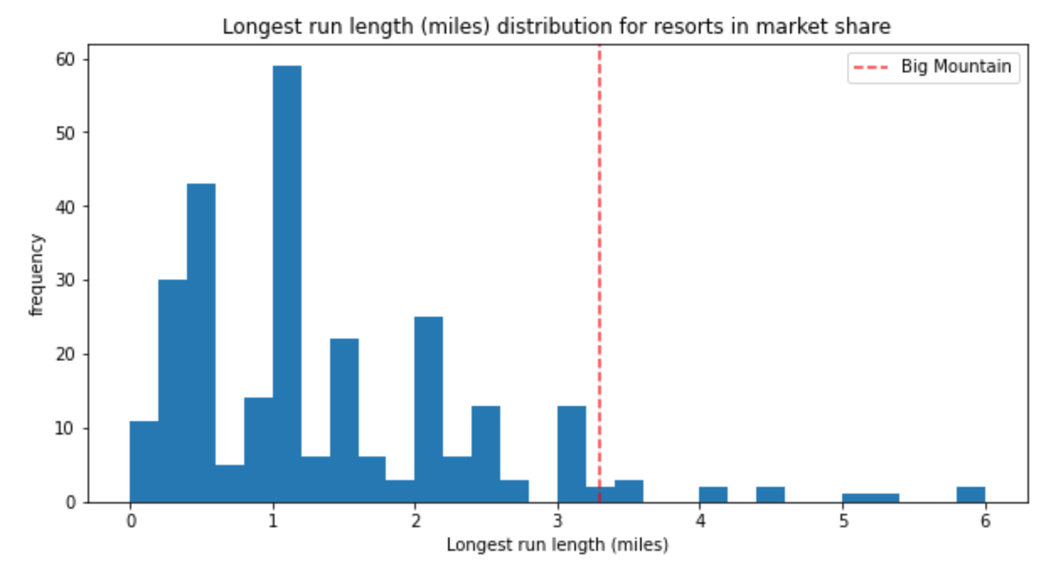
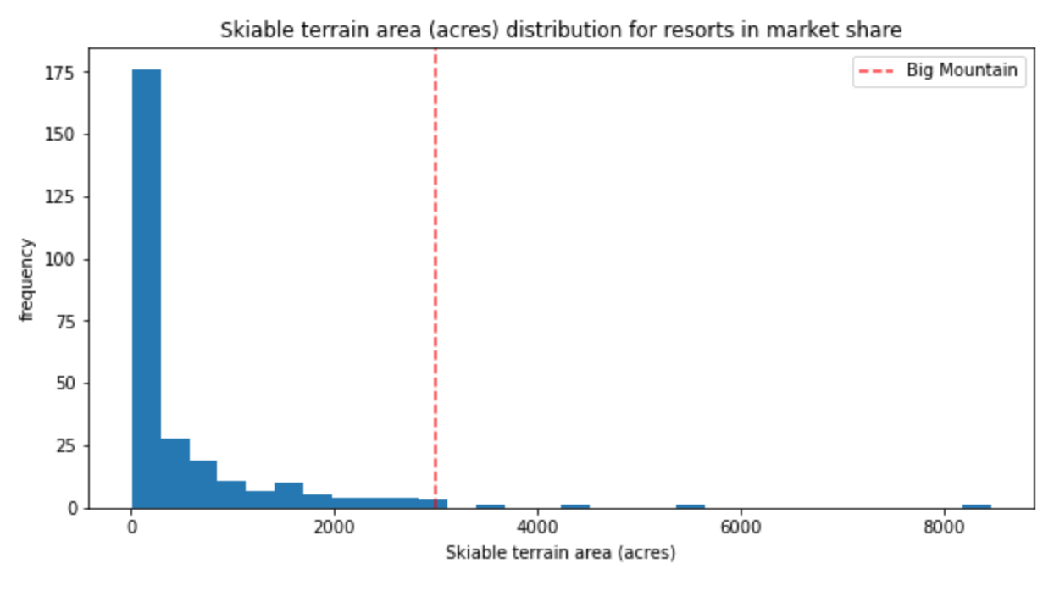
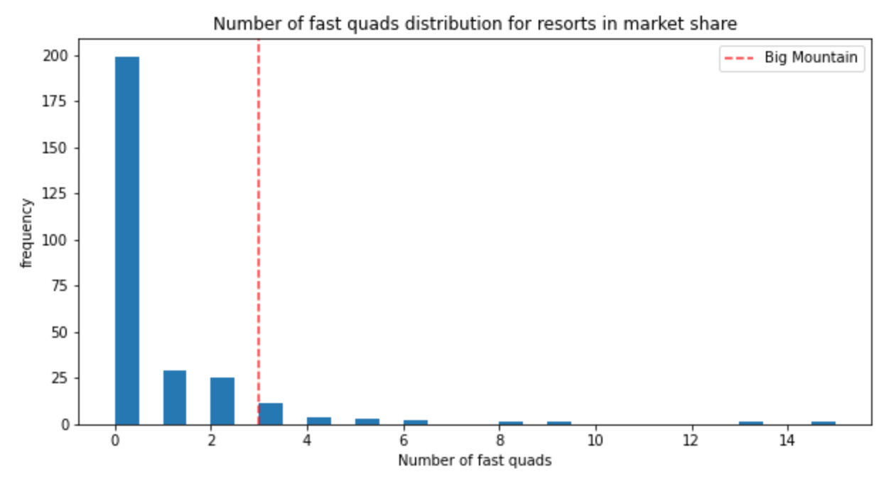
Modeling Results and Analysis
Correlations with ticket price visualized in histograms with BMR’s values highlighted:

Slide 9
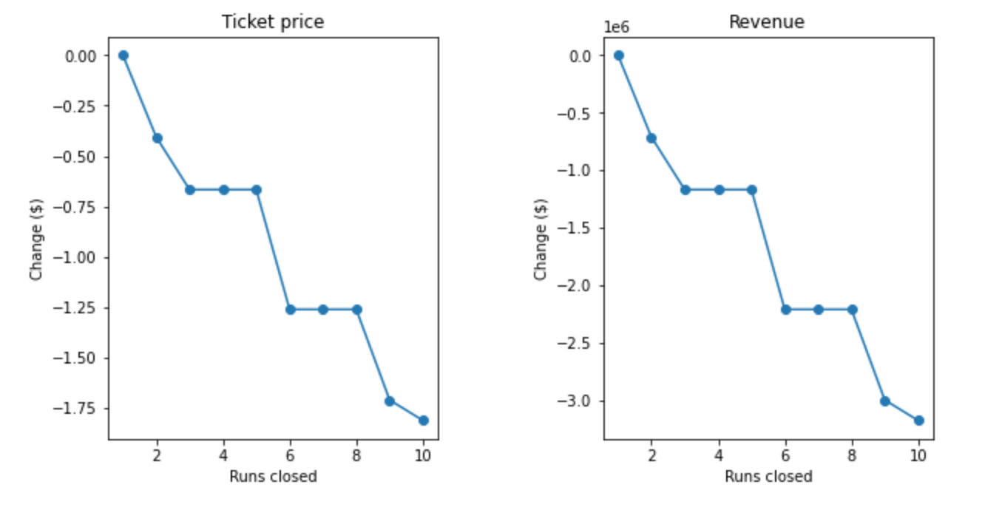
Modeling Results and Analysis
Visualized optimal prices and revenue changes as runs are removed:

Slide 10
Summary and Conclusion
Closing one run could be done without affecting the recommended ticket price.
Not optimal if it affects plans to extend the vertical drop.
An additional chairlift and extended vertical drop (by 150 ft) shows an increase in revenue that makes up for the added cost of the chairlift ($1,540,00 cost)
Expected gain from increasing price by $1.99: $3,474,638
Adding two acres of snowmaking does not affect the optimal ticket price
Adding .2 miles to the current longest run and 4 acres of snowmaking does not affect the optimal ticket price

